Slide 1
CS 489
Final Presentation
Team 9
Jinhyuk, Jaejun, Hyunsoo, Viet

Slide 2
About our research
Research Topic
A user-centered guidance for proactive personal data management and privacy-sensitive user awareness
Research Method
A user study w/implementation and qualitative analysis (e.g., survey)
Notes:
This site was designed to raise user awareness on privacy and personal data protection.
We inform users of passive data collection that occurs at popular websites and guide them to make better use of web surfing.

Slide 3
Research Motivation
A lot of people do not read the private policy of websites and proceed to use them with no worries
They do not have detailed information about what sort of private information websites take when they use them
Some websites exploited the user information they took without consent.(ex. Facebook)
However, little to no effort existed to keep people safe from such exploitations
Notes:
Quite many users are aware of privacy features and know how to use them, but they do not take initiative to protect their information (see e.g. Acquisti & Gross, 2006; Dwyer, 2007; Govani & Pashley, 2005; Gross & Acquisti, 2005; Jones & Soltren, 2005). For example Acquisti and Gross (2006) show in their study that the majority of Facebook members claim to know about ways to control the visibility and searchability of their profiles, but only a significant minority (30% of students in their sample), are unaware of those tools and options. Jones and Soltren (2005) put the figures for students in their sample at 74% being familiar with the privacy feature, of which only 62% actually using the features to some degree.

Slide 4
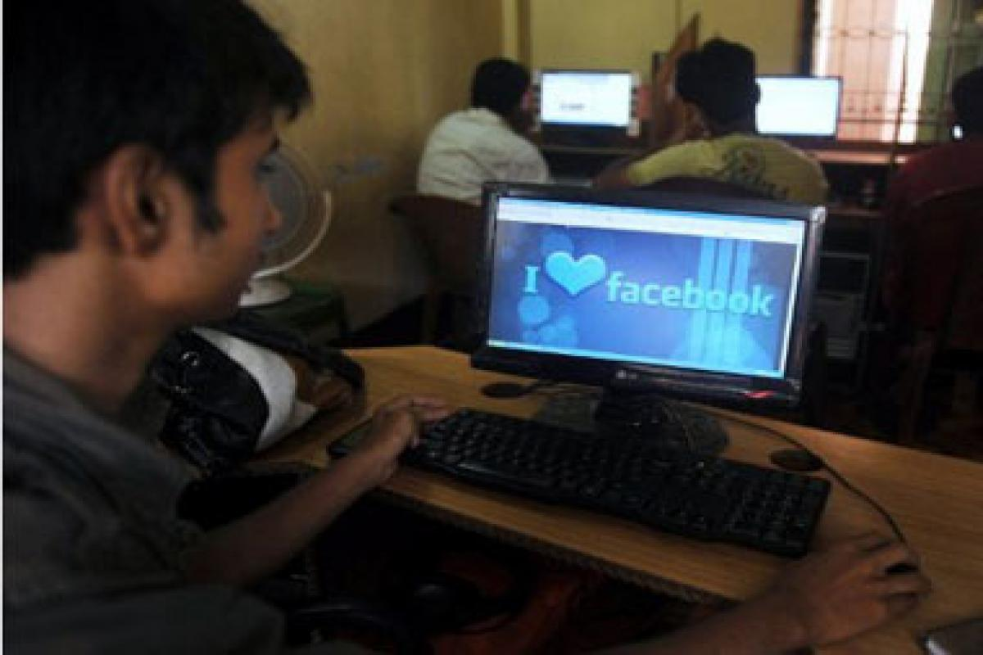
Previous Research
Majority of Facebook members claim to know about ways to control the visibility and searchability of their profiles, but only a significant minority (30% of students in their sample), are unaware of those tools and option (Acquisti & Gross, 2006; Dwyer, 2007; Govani & Pashley, 2005; Gross & Acquisti, 2005; Jones & Soltren, 2005)
People lack attention and knowledge in going through privacy policies in Android permissions (Soups 2012)

Slide 5
Research Goal
Let as many people as we can know about the
reality of how much personal information
is taken from web services they are using

Slide 6
Research Procedure
Pre-Survey (N = 24)
A survey was conducted to explore people’s general perception and level of concern in data collection
A well-known survey was contextualized for our survey (IUIPC scale, Malhotra et al., 2004)
Website selection and data browsing
We selected popular websites commonly cited from people and scraped privacy policy information
List of websites: Stackoverflow, Naver, Google, Amazon, Facebook/Instagram, Slack, IEEE, Github

Slide 7
Research Procedure
3. Data categorization
After listing up data from each websites, we thematically coded and classified data
Category | Sub-Category | Types
Privacy-Sensitive | Personal info | age, gender, email address, phone number, financial info
 | User activity | browsing history, views
 | Location info | delivery address, GPS,
 | Private life | audio, conversation recording
Non-sensitive | Technical info | IP address, crash reports, date/time visits, device type, device activity

Slide 8
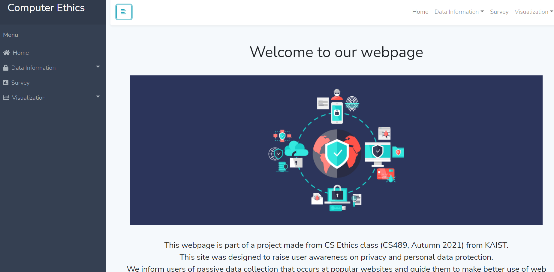
Research Procedure
4. Web app implementation, user experience and post-survey

Slide 9



Website Implementation
React Native
Cloud Firestore
Heroku
Please visit our website: https://cs-ethics.herokuapp.com/
We collect users’ opinions from our survey without collecting any other information from users

Slide 10
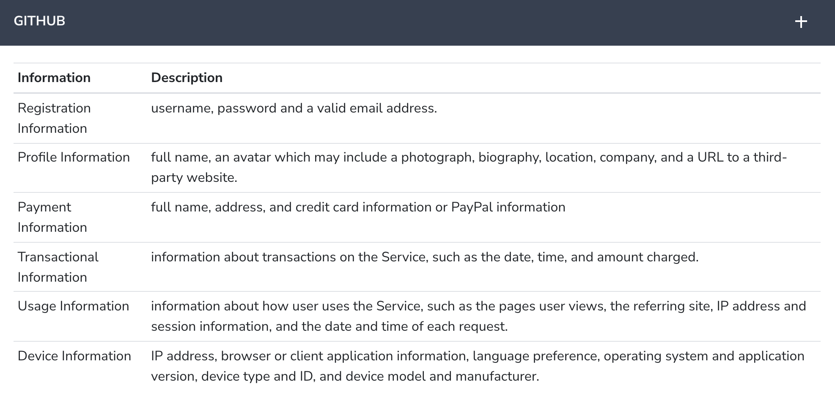
Example

Slide 11
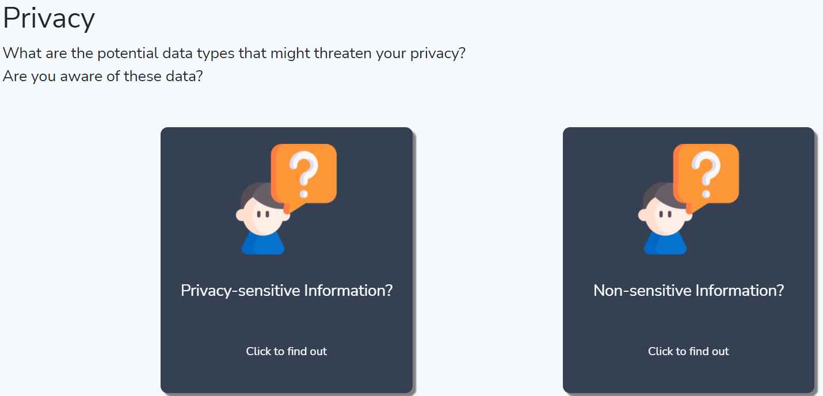
Example

Slide 12
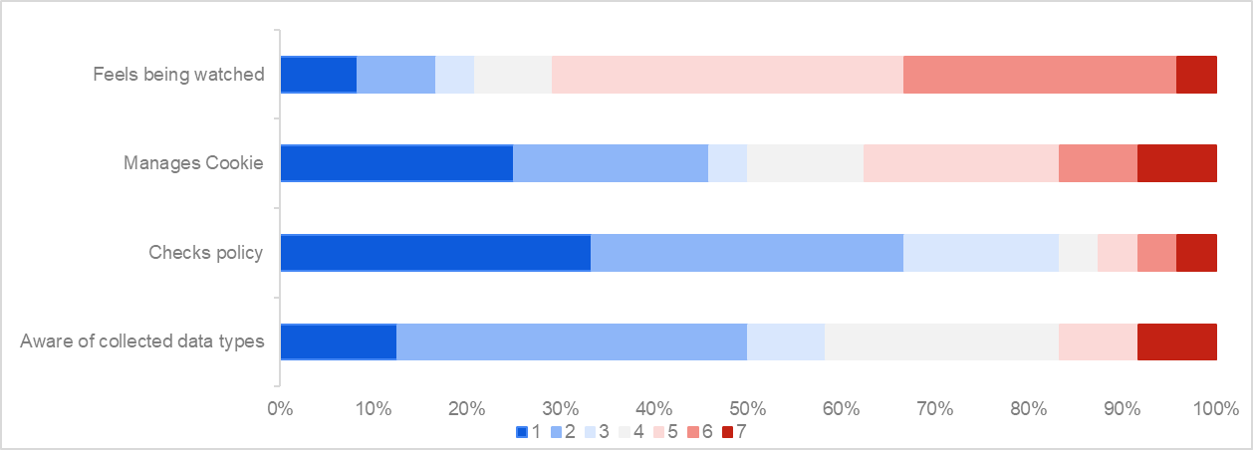
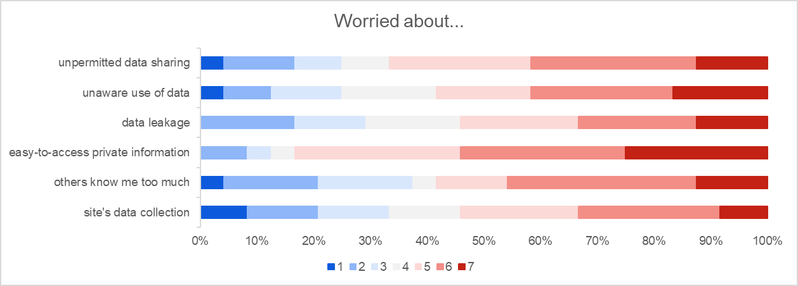
Results
Pre-survey results
We can check that only 16% of participants check policy / aware of collected data types
Worries related to privacy data are generally about 50%

Slide 13
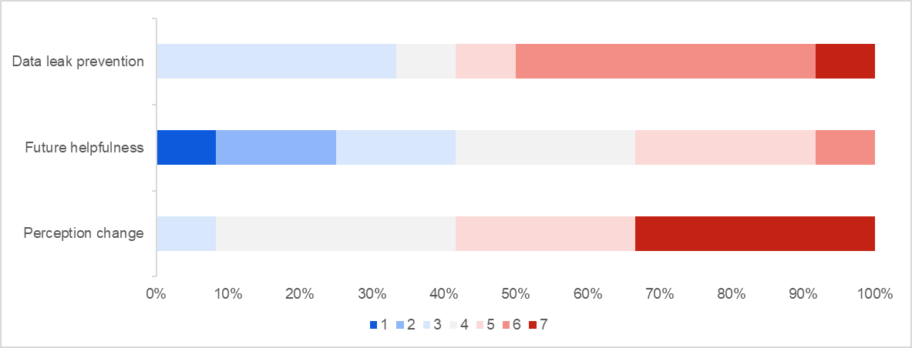
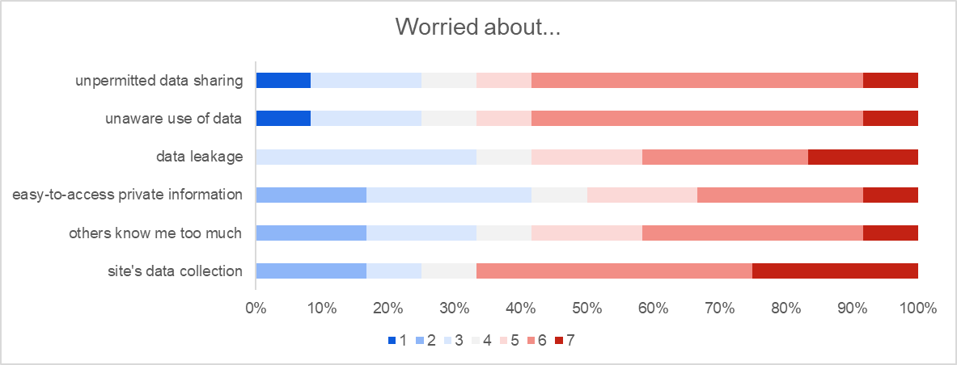
Results
Survey result after website visit (not done yet)
⇒ About 60% of participants changed their perception
Worries generally increased (except worries about easy-to-access private information)

Slide 14
Conclusion
People are generally unaware of privacy policy and types of data being collected
Through our study, a simple guidance/support helps users better shape their understanding of data collection and raise their awareness
We believe providing our service will help people raise their data privacy awareness and lead to proactive management of their privacy

